Slide 1

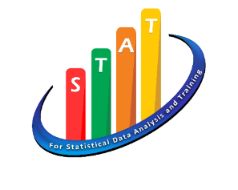

Process Of Data Analysis In Scientific Research
Dr. Hazhar Blbas
Statistics Department - MSc at UCF in 2014
Statistics Department – PhD at SUE in 2022

Slide 2
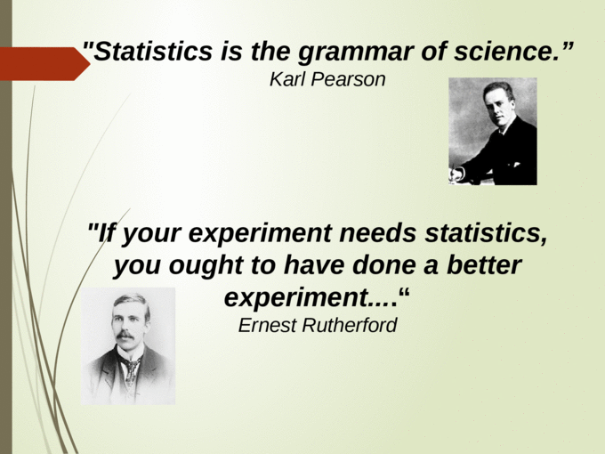
Karl Pearson
“ Statistics is the grammar of Science “
Hazhar Blbas

Slide 3
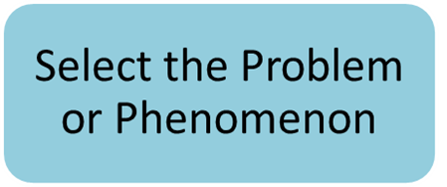
Process of Data Analysis in Scientific Research
Collect the Data
Organize the Data
Analyze the Data
Result
Hazhar Blbas

Slide 4
1- Select the Problem or Phenomenon
Example
Divorce
Reasons for Divorce
Statistical Analysis for the Most Influential Reasons for Divorce
Statistical Analysis for the Most Influential Reasons for Divorce between Men and Women
Statistical Analysis for the Most Influential Reasons for Divorce between Men and Women in Erbil-Iraq
Hazhar Blbas

Slide 5
1- Define the population area of your research
2- Process of Collecting Data
2- Choose the Sufficient sample size using Cochran formula
3- Sampling Plan
4- Source of Data Collection
5- Methods of data collection
6- Construct Questionnaire structure
7- Pilot test OR Pretest
Hazhar Blbas

Slide 6
Calculate Sufficient sample size
Before recruiting participants, decide on your sample size either by
looking at other studies in your field or
using statistics.
Sample size should be representative and unbiased of the population
A sample sample that’s too small may be unrepresentative of the population, while a sample that’s too large will be more costly than necessary.
Continue
Hazhar Blbas

Slide 7
Smartphone for Adults in UK
Suppose that it is wanted to estimate the proportion of the ADULTS who have own smartphone in the UK.
A sample of 100 people has been taken.
If 59 out of 100 people have own smartphone
We estimate the proportion 59/100 = 59% = 0.59
We can construct an interval around this point estimate to express our uncertainty in it, it is mean our “Margin error”
For example, 95% CI for our estimate based on our sample of size 100 ranges from 49.36% to 68.64%

Slide 8
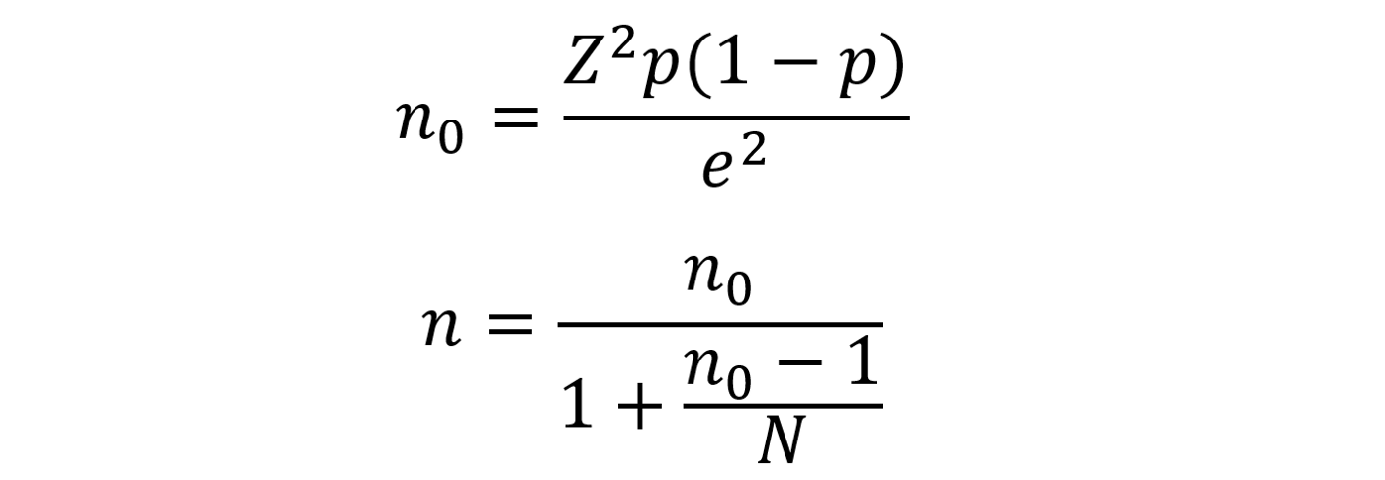
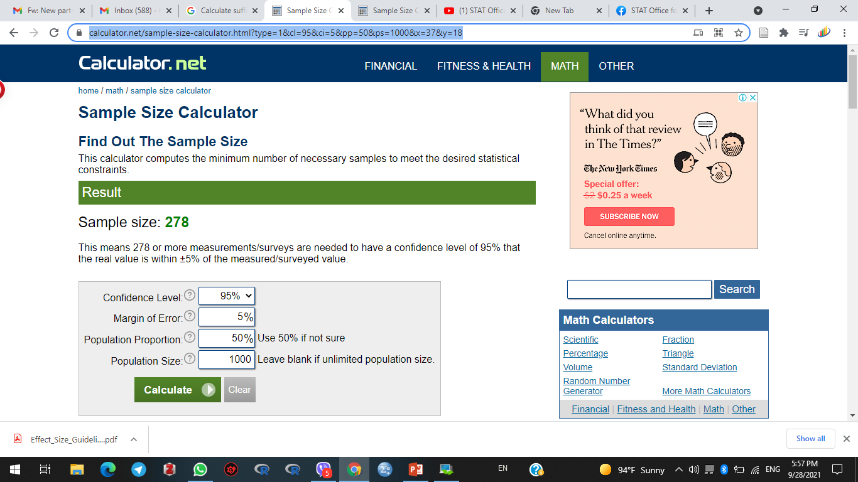
Cochran formula
Z value of 95% Confidence is 1.96
P estimated proportion of the population for e.g. p=0.5
q = 1-P = 0.5
e is error Margin = 0.05 (5%)
N is population size = 1000
Sample Size (n) = 278
https://www.calculator.net/sample-size
Hazhar Blbas

Slide 9
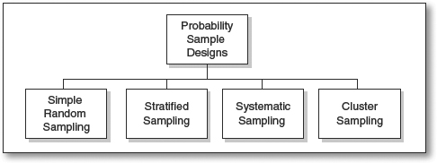
Sampling Plan
Once the target population has been identified, next the sampling plan must be devised.
There are Two General Types of Sampling Techniques:
A. Probability (Random) Sampling
Every element in the population has an equal chance of being chosen.
Hazhar Blbas

Slide 10
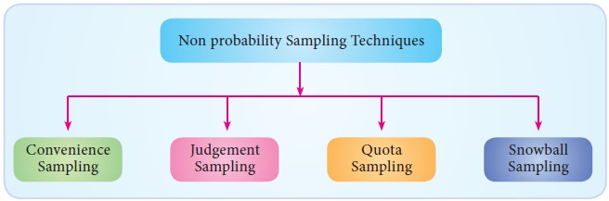
B. Nonprobability Sampling
Every element in the population does not have an equal probability of being chosen.
Hazhar Blbas

Slide 11

Definition of Data
Data are special type of information, generally obtained through observation, surveys, or are generated as a result of human activity for the purpose of research.
Data is a universal language allowing scientists to work together no matter where they are and when do they live.
Data collection is the most important step. If the collected data is wrong, analyses and conclusions can not be right!
Hazhar Blbas

Slide 12
Understanding Data, Information, Knowledge and Wisdom
it is very difficult to walk 100 miles by any person but vehicle transport
Wisdom
Information
Data
Knowledge
100 miles is a quite far distance
100 miles
100
Hazhar Blbas

Slide 13
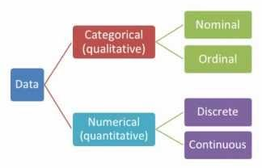
Types of Data
Hazhar Blbas

Slide 14
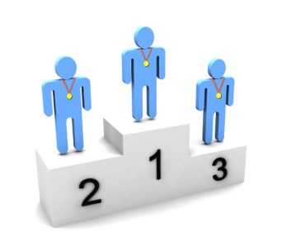

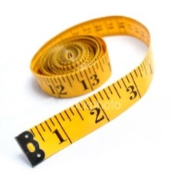
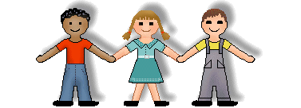
Types of Data
Variables
Scale
Categorical
Continuous
Measurements
takes any value
Discrete:
Counts/ integers
Ordinal:
obvious order
Nominal:
no meaningful order
Notes:
Categorical variables can be divided into two: ordinal and nominal. If the categories are meaningfully ordered, the variable is ordinal; if it doesn’t matter in which way the categories are ordered, then the variable is nominal. For example, satisfaction levels (dissatisfied, satisfied and highly satisfied) and education level (secondary, sixth form, undergraduate and postgraduate) are ordinal variables; Student’s religion (Christian, Muslim, Hindu, etc) and favourite animal are nominal variables.
Scale variables appear as meaningful comparable numbers, such as blood pressure, height, weight, income, age, and probability of illness etc. Numerical variables can be further divided into two subtypes: continuous and discrete. The continuous variables can take any value within a range and are the most common, e.g. body weight, height, income, etc. Discrete variables can only take whole numbers, such as number of students in class, number of new patients every day, etc but are treated as continuous for statistical analysis if there are a large range of numbers.
One point to make is that if ordinal data is scored as ranks such as 1, 2, 3 etc., and then this data is analysed as scale data, then a rather strong assumption is being made that the distances between the value of any pair of neighbouring ranks (e.g. 1 and 2 or 2 and 3 etc.) is the same, which is unlikely in practice to be true. Students often find the difference between ordinal and discrete difficult especially when ordinal is categorised as numbers
The point is that whilst this might not be the most interesting place to start – students need to be aware of the data they have since this affects what analyses are/not suitable.

Slide 15
Questionnaire for STAT Students at SUE
What data types relate to following questions?
Q1: What is your favourite subject?
Q2: Gender:
Q3: I consider myself to be good at Statistics:
Q4: Score in a recent score of STAT exam:
Nominal
Maths | English | Science | Art | French
Male | Female
Binary/ Nominal
Strongly Disagree | Disagree | Not Sure | Agree | Strongly Agree
Ordinal
Scale
Score between 0% and 100%
Notes:
The answers. Point out that binary variables are a special case of nominal variables.
Ordinal variables are the one students get most confused about. Make it clear that although we usually number categorical variables in SPSS, this does not make them scale. The numbers are just labels. People come 1st, 2nd, 3rd etc in a race but the distance between 1st and 2nd may not be the same as the distance between 2nd and 3rd.

Slide 16
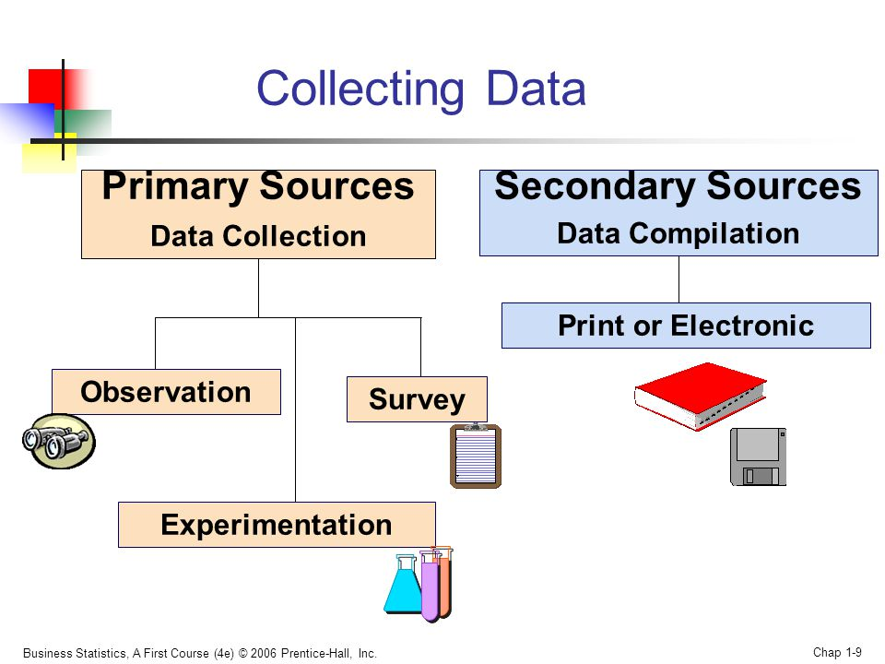
Source of Data Collection
A- Primary Source Data
Data was collected by your self using a questionnaire form,
B- Secondary Source Data (Historical Source)
Those data which have been collected by someone else
Hazhar Blbas

Slide 17
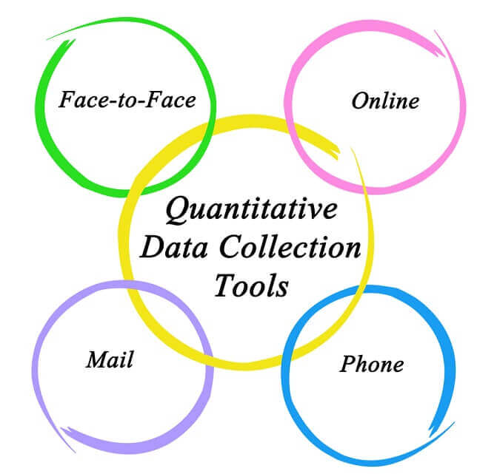

Methods of data collection
  Mixed mode: uses two or more of above
Which methods of Data Collection should I choose?
Hazhar Blbas

Slide 18
Questionnaire structure (Cont.)
Questionnaire development is more an art than a science and it always takes longer than you expect. Plan on writing several draft questionnaires.
Well designed questionnaires are highly structured so that the data can be analysed quantitatively and systematically.
Hazhar Blbas
Notes:
elicits / elisit / to get information OR a reaction for someone

Slide 19
How should I begin?
Write personalized cover letter or an introductory statement that:
explains the purpose of the survey, the importance of the respondent’s participation, the person who is responsible for the survey.
A good way to start is:
- “Hello. My name is (your name) and I am student at (your school or institution). I’m working on a research project looking at (title of your research project) for a course called ( your course name). I was wondering if you have a few minutes to answer some questions dealing with my research.”
At the end always thank the respondent for participating in your questionnaire.
Hazhar Blbas
Notes:
An article appearing in the International Journal of Market Research gives great advise about questionnaire design. This youtube video summarizes the findings in the article http://www.youtube.com/watch?v=53mASVzGRF4.

Slide 20

Types of Questions:
A- Closed Format
  Respondents are forced to choose between several given options.
  Multiple choice, yes/no and ranking
  Easy and quick to fill in
  Easy to code, record, and analyse
  results quantitatively
  Easy to report results
Hazhar Blbas

Slide 21

B- Open Format:
allow the respondent to freely answer the question.
  Less restrictions and allows for more depth in the overall answer.
  use the open format if you are looking for
  respondents to provide specific comments
  or feedback.
  for example
  age ???
  Experience Year ???
  Feed back of restaurant
Hazhar Blbas

Slide 22
How do I ask the questions? Cont.
Use short and simple sentences.
Follow the “KISS” method meaning “Keep it short and simple!”
Ask for only one piece of information at a time.
  Example: Please rate the Global Environment Class in terms of its content and presentation
  Should be divided into two parts:
  question one: “Please rate the class in terms of its content”
  question two: “Please rate the class in terms of its presentation.
Hazhar Blbas

Slide 23
    Refrain from negatively worded questions (Avoid negatives if possible).
Question: What is your view on the concept that students should not be unhelpful with recruiting new graduate students to the statistics department.
Revision: What is your view on the concept that students should be helpful with recruiting new graduate students to the statistics department.
Hazhar Blbas
Notes:
I was stop here on Tuesday 22/11/2016

Slide 24
  Start with questions relevant to the main subject
  Questions should be in logical orders, moving from easy to more difficult questions..
  Start with closed format questions.
  Personal questions should be avoided.
  The wording of the questions should be proper without hurting the feelings.
  Questions should be carefully framed so as to cover the entire scope of the survey
  As far as possible secret information should not be sought
  Questions fetching YES or NO answers are preferable.
Questionnaires must first be piloted and evaluated before the actual survey
Hazhar Blbas

Slide 25
Pilot test OR Pretest
A pretest of the survey to a smaller sample is suggested if possible.
This pretest can
  Allow you to revise the questionnaire if needed.
  Allow you to create a closed question from the responses for an open question.
  Help you estimate the variability in the responses to your questions and determine the necessary sample size.
  Allow you to discuss to your friends or teachers
Hazhar Blbas

Slide 26
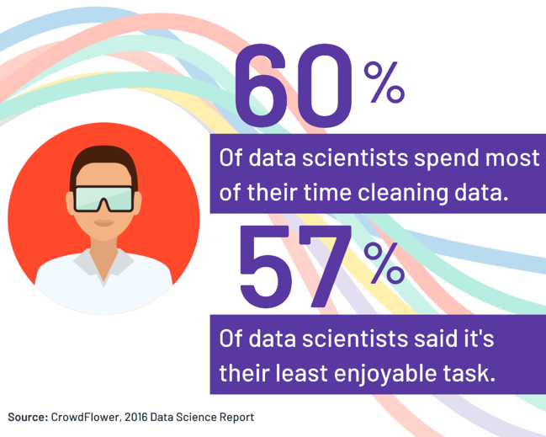
3- Organize the Data
Organize all forms/questionnaire in one place
Put the ID as a name for all forms
Cleaning the Data and Coding
Remove duplicate cases
Remove incomplete cases
Find Outliers
Find Missing data
The data should be cleaned and error free
Make transformations of variable as needed
Hazhar Blbas

Slide 27
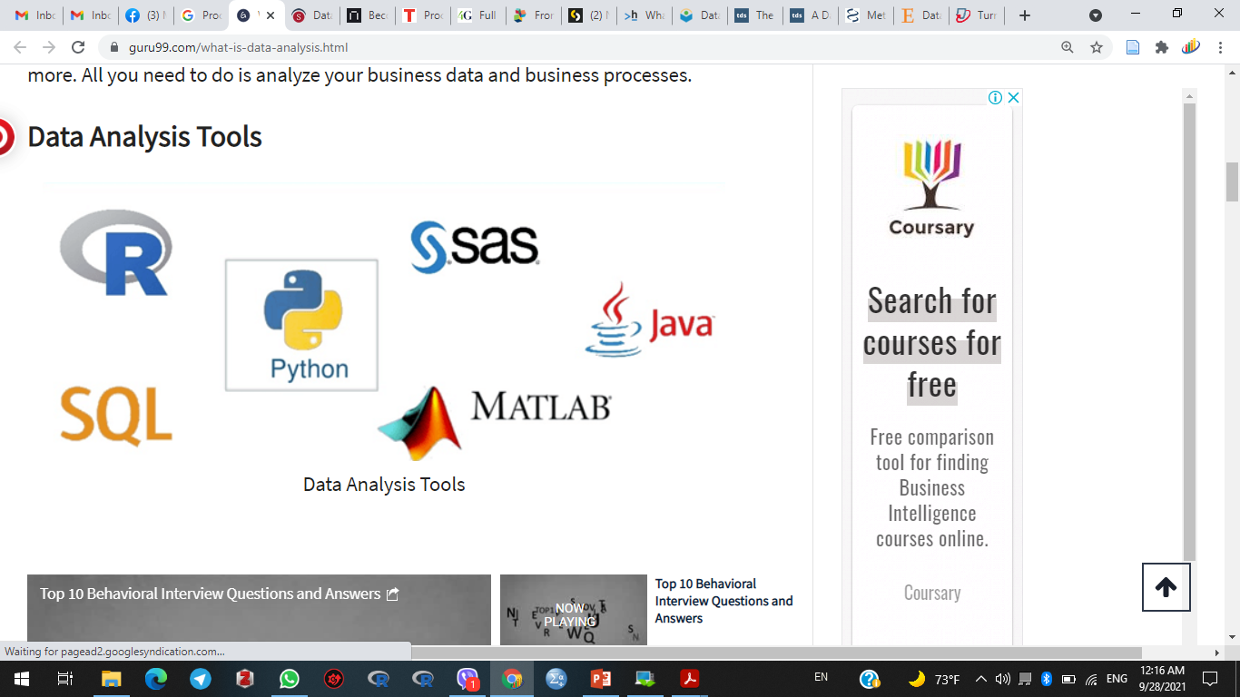
Data analysis tools make it easier for users to process , data entry, and analyze data
4- Analyze the Data
Once the data is collected, cleaned, and processed, it is ready for Analysis. OR you might need to collect more data
Data analysis means a process of cleaning, transforming and modeling data to discover useful information for business decision-making
Hazhar Blbas

Slide 28
Goal of data analysis
The goal is to obtain usable and useful information.
• To identify and understand patterns in data
• To identify relationships between variables
• To compare variables and identify the difference between variables
• To explain cause-and-effect phenomena
• To forecast outcomes
Hazhar Blbas

Slide 29
Two Main Statistical Methods are used in
Data Analysis:
1- Descriptive statistics which summarize (describe) data from a sample using indexes such as the
Frequency Table,
Charts:- Line Chart, Frequency polygon, Frequency curve, Histogram, Bar Chart, Scatter plot, and Pie chart
Measures of Central Tendency:- Mean, Median, and Mode
Measures of Dispersion:- Range, Variance, and Standard deviation,
Hazhar Blbas

Slide 30
Numerical Presentation
H. Blbas, “Statistical Analysis for the Most Influential Reasons for Divorce between Men and Women in Erbil- Iraq,” Oct. 2019.
Gender | Frequency | %
Male | 240 | 48.6
Female | 254 | 51.4
Total | 494 | 100
Frequency Table represents of 494 divorce applicants who were divorced in Erbil-Iraq in 2017
Frequency Table between Men and Women for Level of Education
 |  | Men |  | Women
 |  | F | % | F | %
Level of Education | Illiterate | 44 | 18.30% | 44 | 17.30%
 | Elementary | 40 | 16.70% | 48 | 18.90%
 | Secondary | 50 | 20.80% | 44 | 17.30%
 | High School | 44 | 18.30% | 42 | 16.50%
 | More than HS | 62 | 25.80% | 76 | 29.90%
Hazhar Blbas

Slide 31
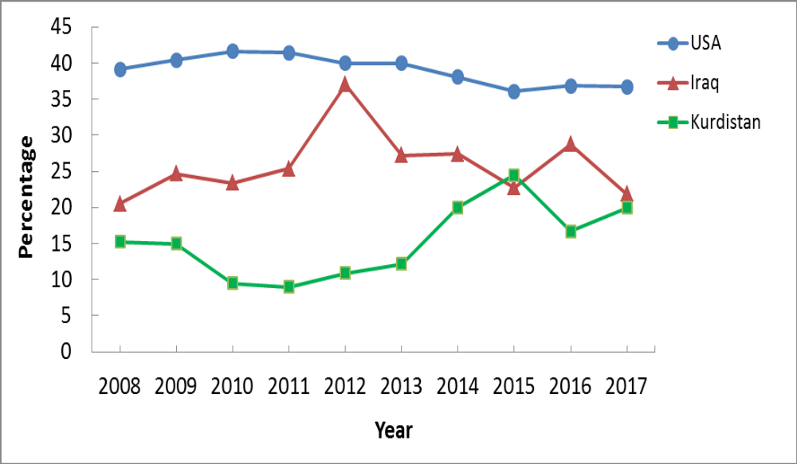
Graphical Presentation
H. Blbas, “Statistical Analysis for the Most Influential Reasons for Divorce between Men and Women in Erbil- Iraq,” Oct. 2019.
Bar Chart shows the percentage of 494 divorce applicants who were divorced in Erbil-Iraq in 2017
Line Chart shows the percentages of divorce among the USA, Iraq, and Kurdistan
Hazhar Blbas

Slide 32
Which graph is correct?
1st variable | Only 1 variable | Scale | Categorical
Scale | Histogram | Scatter plot | Box-plot/ Confidence interval plot
Categorical | Pie/ Bar | Box-plot/ Confidence interval plot | Stacked/ multiple bar chart
Which graph would you use when investigating:
Whether daily temperature and ice cream sales were related?
Scatter
Comparison of mean reaction time for a group having alcohol and a group drinking water
Boxplot or confidence interval plot
Notes:
Use a scatterplot as both variables are scale
Use a boxplot or CI plot as reaction time is scale and the independent variable is categorical

Slide 33
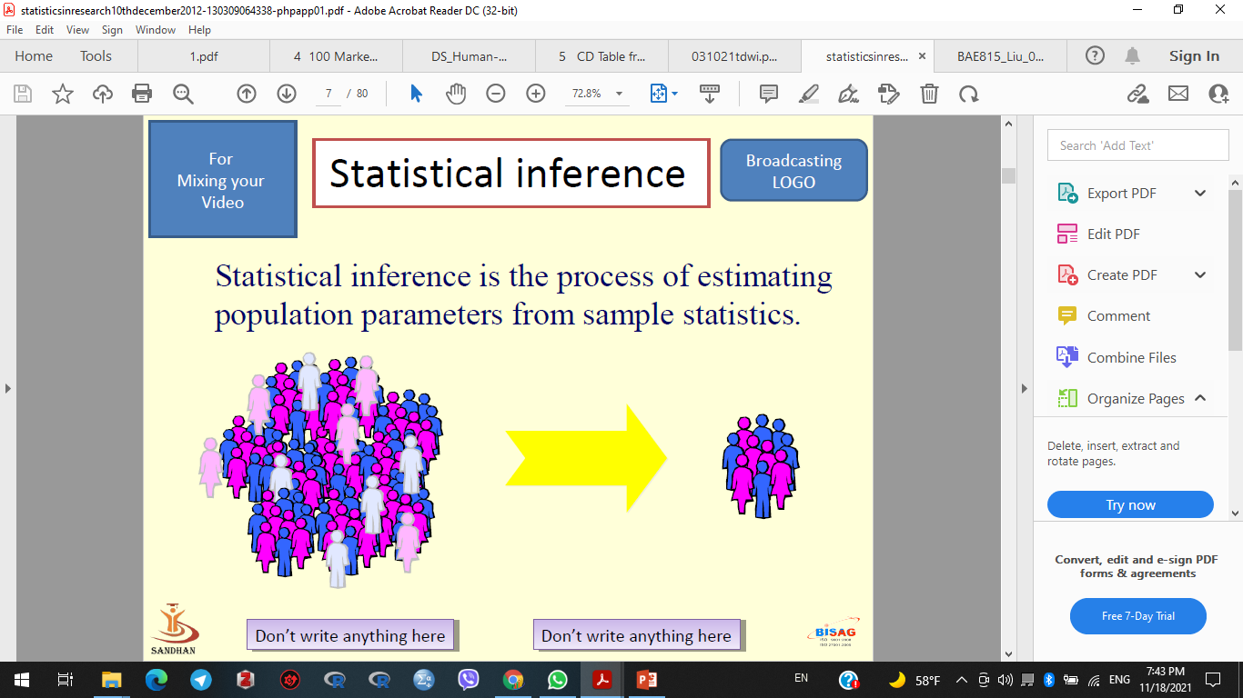
2- Inferential statistics is the process of
estimating population parameters from
sample statistics such as
Hypothesis test:- usually compare the means of groups
One Sample T Test, Independent Sample T Test, Paired Sample T Test, and One way ANOVA,
Chi-Square Test – Both datasets should be nominal
Correlation, Regression - Both datasets should be scales
Assess cause-and-effect relationships between variables.
Factor Analysis.
Time Series Analysis, …, etc
Hazhar Blbas

Slide 34
Comparing means
Independent t-test
2
Comparing BETWEEN groups
One way ANOVA
3+
Comparing means
Paired t-test
Comparing measurements WITHIN the same subject
2
Repeated measures ANOVA
3+
ANOVA = Analysis of variance

Slide 35
Blbas, H.T.A., Aziz, K.F., Nejad, S.H. and Barzinjy, A.A. (2020). Phenomenon of depression and anxiety related to precautions for prevention among population during the outbreak of COVID-19 in Kurdistan Region of Iraq: based on questionnaire survey. Journal of Public Health.‌
Mathematical Presentation
Independent Sample T Test and One way ANOVA,
 |  | Overall Depression
 |  | Mean | SD | F-value (t-value) | P-value
Gender | Male | 3.93 | 0.67 | (−2.94) | 0.003*
 | Female | 4.06 | 0.63
Age | under 20 years | 4.24 | 0.67 | 1.76 | 0.135
 | 20–29 | 3.98 | 0.71
 | 30–39 | 4.01 | 0.62
 | 40–49 | 3.94 | 0.62
 | 50 years and above | 3.86 | 0.6
Assumptions ???
Hazhar Blbas

Slide 36
Two categorical variables
Test: Chi-squared
Tests for a relationship between two categorical variables
Example:
Are boys more likely to prefer maths and science than girls?
Variables:
Favourite subject (Nominal) [ Mathematics or Science]
Gender (Binary/ Nominal) [ Male or Female]
Notes:
We’ve already looked at a chi-squared test which looked for an association between survival and class on the Titanic. The chi-squared test looks for an association between two categorical variables. Another example is looking at whether boys are more likely to prefer maths and science subjects than girls. You could ask students which subject was their favourite subject (nominal) and note whether they were male and female (binary). You could then summarise the sample data using a stacked/ multiple bar chart and test for a relationship in the population using a chi-squared test.

Slide 37
Chi-square test shows that there are statistical differences between men and women regarding ……..
Mathematical Presentation
H. Blbas, “Statistical Analysis for the Most Influential Reasons for Divorce between Men and Women in Erbil- Iraq,” Oct. 2019.
Common cause of divorce | Men= |  | Women= |  | P-value
 | 240 |  | 254
 | Mean(F) | SD(%) | Mean(F) | SD(%)
Second marriage | 3.06(208) | 1.349(42.1) | 3.5(286) | 1.447(57.9) | 0.035
Stingy | 3.09(212) | 1.264(42.9) | 3.46(282) | 1.441(57.1) | 0.008
Dominance in marriage | 3.27(206) | 1.282(43.7) | 3.57(278) | 1.36(56.3) | 0.001
The couple's parents interfere in their lives | 3.46(230) | 1.408(46.6) | 3.67(264) | 1.357(53.4) | 0.048
Infertility | 2.99(205) | 1.033(41.5) | 3.11(289) | 1.17(58.5) | 0.002
Modern Technology (Mobile – Social Media) | 3.23(254) | 1.301(51.4) | 3.12(240) | 1.372(48.6) | 0.01
Hazhar Blbas

Slide 38
What if the assumptions are not met?
There are alternative tests which do not have these assumptions
Test | Check | Equivalent non-parametric test
Independent t-test | Histograms of data by group | Mann-Whitney
Paired t-test | Histogram of paired differences | Wilcoxon signed rank
Notes:
You could say that we’ll talk about these non-parametric tests in more detail later

Slide 39
Blbas, Hazhar. (2016). Elementary Statistics: First Edition.‌
Mathematical Presentation
Correlation Analysis
Correlation Coefficient Methods
1- Scatter Plot
2- Karl Pearson’s Coefficient
3- Rank Spearman Coefficient
Example 7.1: Age and Systolic Blood Pressure – Page 222
Correlation is 0.99 – Strong Positive Correlation between age and blood pressure
Hazhar Blbas

Slide 40
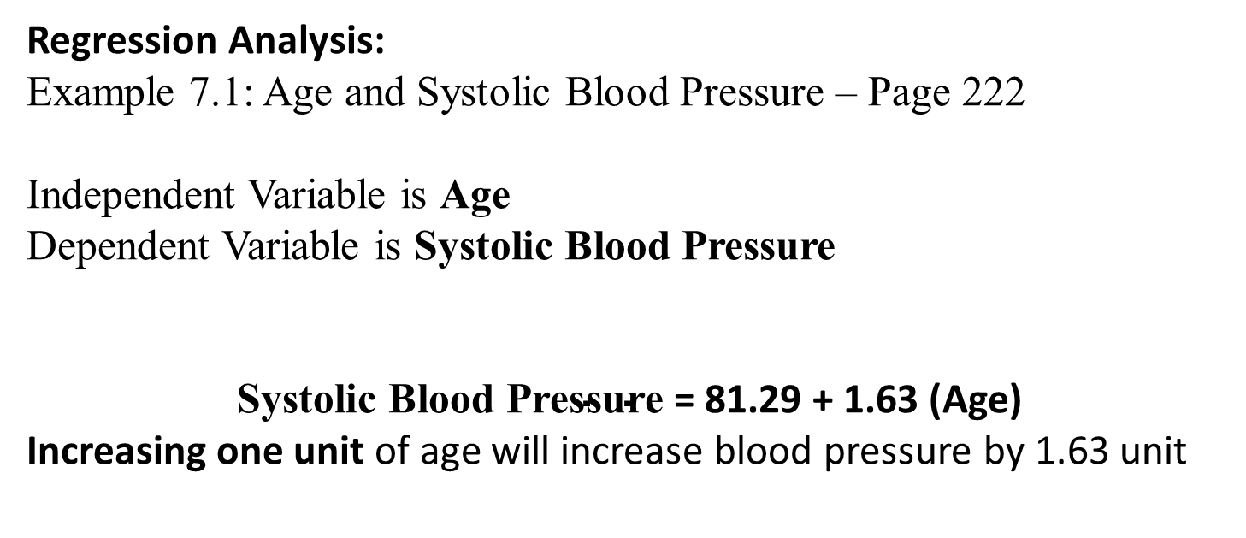
Blbas, Hazhar. (2016). Elementary Statistics: First Edition.‌
Mathematical Presentation
Assumptions- Linearity, Independent of error, Normality of error, and equal variance
Regression Analysis:
Example 7.1: Age and Systolic Blood Pressure – Page 222
Independent Variable is Age
Dependent Variable is Systolic Blood Pressure
$\text{Systolic} \text{Blood} \text{Pressure}$ = 81.29 + 1.63 (Age)
Increasing one unit of age will increase blood pressure by 1.63 unit
Hazhar Blbas

Slide 41
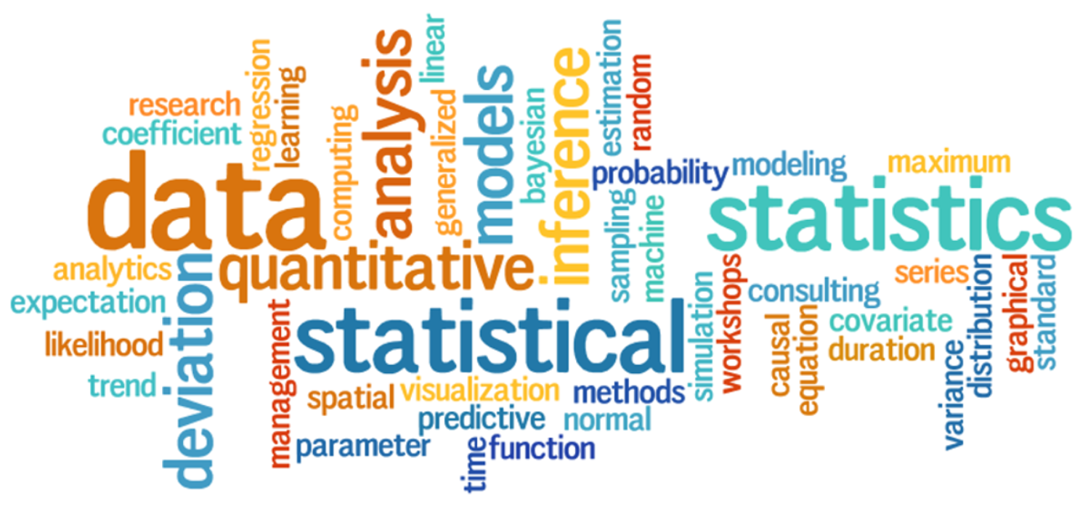
Thank you for your attending
Hazhar Blbas
Notes:
Devonne

Slide 42
Exercise: Solution
Research question | Dependent variable | Independent variable | Test
Do women do more housework than men? | Housework (hrs per week) (Scale) | Gender (Nominal) | Independent t-test
Does Margarine X reduce cholesterol? Everyone has cholesterol measured on 3 occasions | Cholesterol (Scale) | Occasion (Nominal) | Repeated measures ANOVA
Which of 3 diets is best for losing weight? | Weight lost on diet (Scale) | Diet (Nominal) | One-way ANOVA
Notes:
Go through the solutions making everyone understands why each test is appropriate.

Slide 43
Exercise: Solution
Research question | Dependent variable | Independent variables | Test
Does attendance affect exam score? | Exam score (Scale) | Attendance (Scale) | Correlation/ regression
Do women do more housework than men? | Housework (hrs per week) (scale) | Gender (Binary) Hours worked (Scale) | Regression
Were Americans more likely to survive on board the Titanic? | Survival (Binary) | Nationality (Nominal) | Chi-squared
 | Survival (Binary) | Nationality , Gender, class | Logistic regression
Note: There may be 2 appropriate tests for some questions
Notes:
Go through the solutions

