Slide 1

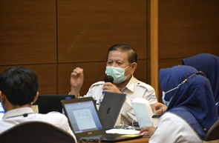

Slide 2
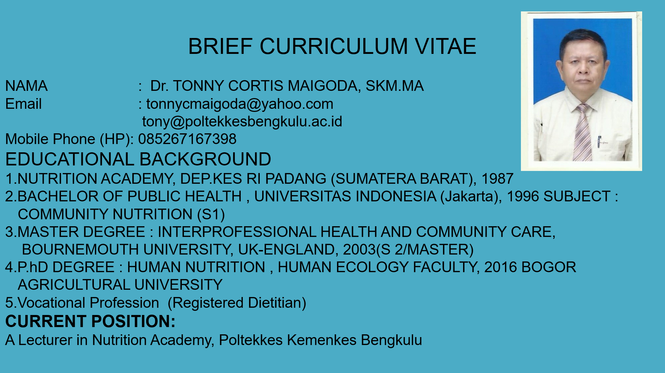

Slide 3







Outline Presentation
What is the role of State of the art in Research
What we should do to create SOTA (State of the art)
Why is it Important
How to write SOTA in our Research Proposal
How to find Research Gap
Let's see my Case
Novelty and Knowledge Contribution
Conclusion

Slide 4
What Is State Of The Art In Research?
The State of the Art is usually the larger part of a research proposal, so it is expected that it will expand over various paragraphs and sub-paragraphs. This section should also be accompanied by comprehensive references, which you include at the end of the proposal.
The term "State-of-the-art" or abbreviated SoTA is often tied to the term "Cutting Edge" or "Leading Edge" which means the highest & latest level of developing a particular tool/technique/research topic.

Slide 5
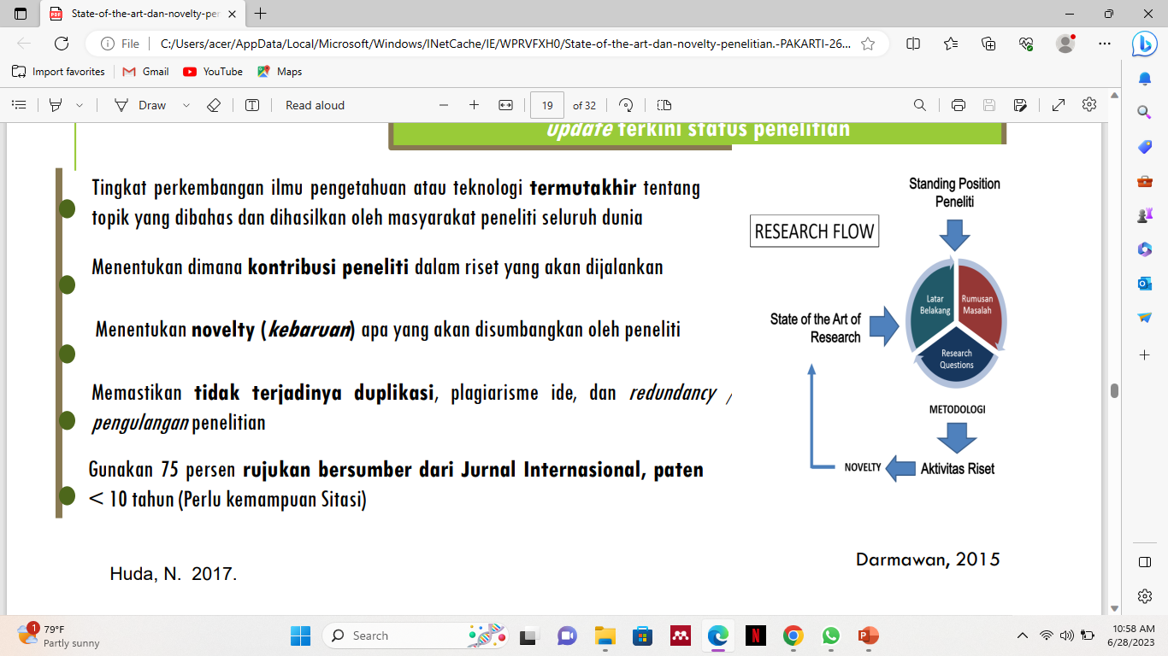
STATE OF THE ART & NEW RESEARCH
State of the Art is not just a Literature Review the latest update on research status
The latest level of development of knowledge science or teknology topics discussed and produced by the research community around the world
Determining where the contribution of researchers in research that is discounted is considere
Determining novelty (what novelty is yong will contributed by the author
Ensure there is no duplication, plagiarism of ideas, and redundancy research repetition
Use 75 percent of referrals come from the International Journal, patents
Standing Position of The Researcher
Background
Formulation of the Problem
Methodology
Research Activity

Slide 6

State of Art
A state-of-the-art review considers mainly the most current research in a given area or concerning a given topic. It often summarizes current and emerging practical trends, research priorities and standardization in a particular field of interest”. (Elsevier.com)

Slide 7
very modern and using the most recent ideas and methods: (Cambridge Dictionary)
If you describe something as state-of-the-art, you mean that it is the best available because it has been made using the most modern techniques and technology. (Collins Dictionary)
: the level of development (as of a device, procedure, process, technique, or science) reached at any particular time usually as a result of modern methods (Merriaem Webster) the latest and most sophisticated or advanced stage of a technology, art, or science. (ThesaUrus)
State of the art in research
In scientific writing, the state of the art describes the current knowledge about the studied matter through the analysis of similar or related published work

Slide 8
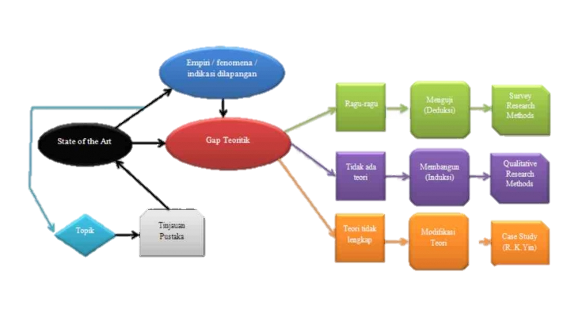
Empirical/ Phenomena/
Indications in The field
Doubtful
Test (Deduction)
Survey Research Methods
State of Art
Theoretical Gaps
No Theory
Build (Induction)
Qualitative Research Methods
Topic
Literature Review
Modification
Theory
Incomplete Theory
Case Study

Slide 9

Why is it Important?
To identify major concepts, ideas, andresults within within the sources that willfit and relevant with our research
To find out research gaps that will lead us to determine our research novelty, research question and knowledge contribution.

Slide 10

Besides demonstrating the novelty of your research results, a SoTA has other important properties:
It teaches you a lot about your research problem.
It proves that your research problem
has relevance
It shows what you can reuse from what others have done
SOTA
It shows different approaches to a solution

Slide 11

Research Gaps:
"Unexplored parts or parts which has been explored but not yet comprehensively or in depth"

Slide 12

Tips for finding research gaps:
Looking for inspiration from published literature
Raise the latest topics
Look at previous articles that are in the type of article review bibliometrics studies, or meta-analyses
See the "direction for further studies" section in the previous article
Discussion

Slide 13

Would should we do?
Read, read, and read
intensively and extensively.
Start From Literatures review !!!!

Slide 14

**State-of-the-Art (SoTA) excavated and delivered with LITERATURE REVIEW**
In order for us as researchers to be able to present the State-of-the-art of our research, we must conduct a comprehensive LITERATURE REVIEW regarding:
Understanding of the concepts involved in our research
Theories, models, frameworks, standards, methods and/or technologies that will be referred to or related to our research
Research in the scope of our existing research topics to the most recent.

Slide 15
In the context of research, State-of-the-Art is a part/activity in research that describes:
The most recent research results on our chosen topic?
Recent research trends or Research Priorities of your chosen topic?
Recent research and practical issues (issues) related to the topic we choose?
Current standards of our chosen topic?

Slide 16
How can we formulate the STATE-OF-THE-ART of our research through LITERATURE REVIEW?
To be able to find and write State-of-the-Art research, a researcher must conduct a Literature Review of recent research reports (generally the last 5 years) in relatively large numbers. Researchers must READ a lot, READ, and ACTIVELY/CRITICALLY READ the latest papers related to their research! Through the LITERATURE REVIEW the researcher must be able to:
Identify and understand the main concepts, ideas and findings, common practices, standards and/trends of previous research to the most recent research that are related and in line with our research.
From understanding point 1, we as researchers must be able to identify what Knowledge Gaps (Knowledge Gaps) still exist: they can be things/aspects that have not been researched, still have potential problems, or have not been able to be answered by existing research. so it has the potential to be investigated further.

Slide 17
CONTINUE……
It is from identifying the Knowledge Gaps in point 2 that finally we as Researchers will be able to choose which Knowledge Gaps we will answer with our Research? so we can formulate:
What is the Novelty of our Research? (which distinguishes and becomes the strength of our research from existing studies)
Our Research Questions?
Knowledge Contribution of our research? (preferably able to convey specifically what theory or model will be enhanced from the results of our research?)

Slide 18
CONTINUE……
  From activities 1 to 3 above the researcher will also be able to find academic reasons/justifications for choosing certain research subjects, research scope, research methods, tools/tools used, selected samples, models/frameworks/standards used, and other things done in research activities.

Slide 19
How to write State of The Art in a research proposal?
When writing this section of your proposal, you should aim for
Summarize the current status of knowledge on your topic
Identify gaps in research and development
Offer suggestions for further investigation

Slide 20
A simple tips for writing SOTA
in research proposal
Spend time on analysis and not on making summaries!
04
SoTA is not a one-way road.
01
Be critical when choosing your literature
05
02
Always give credit!
For more advanced writers
Stop reading! Make an
initial selection of
literature
06
03

Slide 21
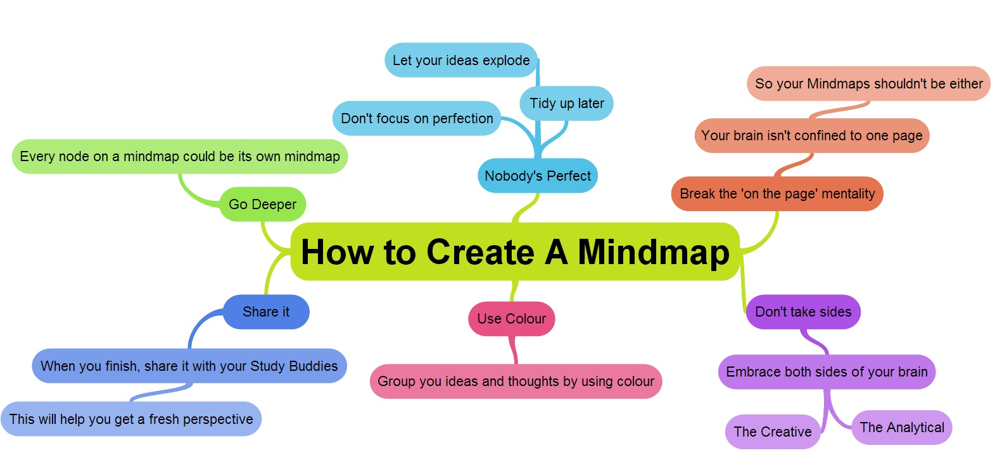
Organizing: Mind mapping

Slide 22
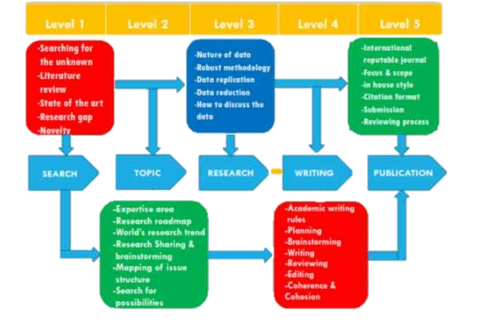
STRWP
model :
Cognitive Model In Scholarly Paper Writing

Slide 23
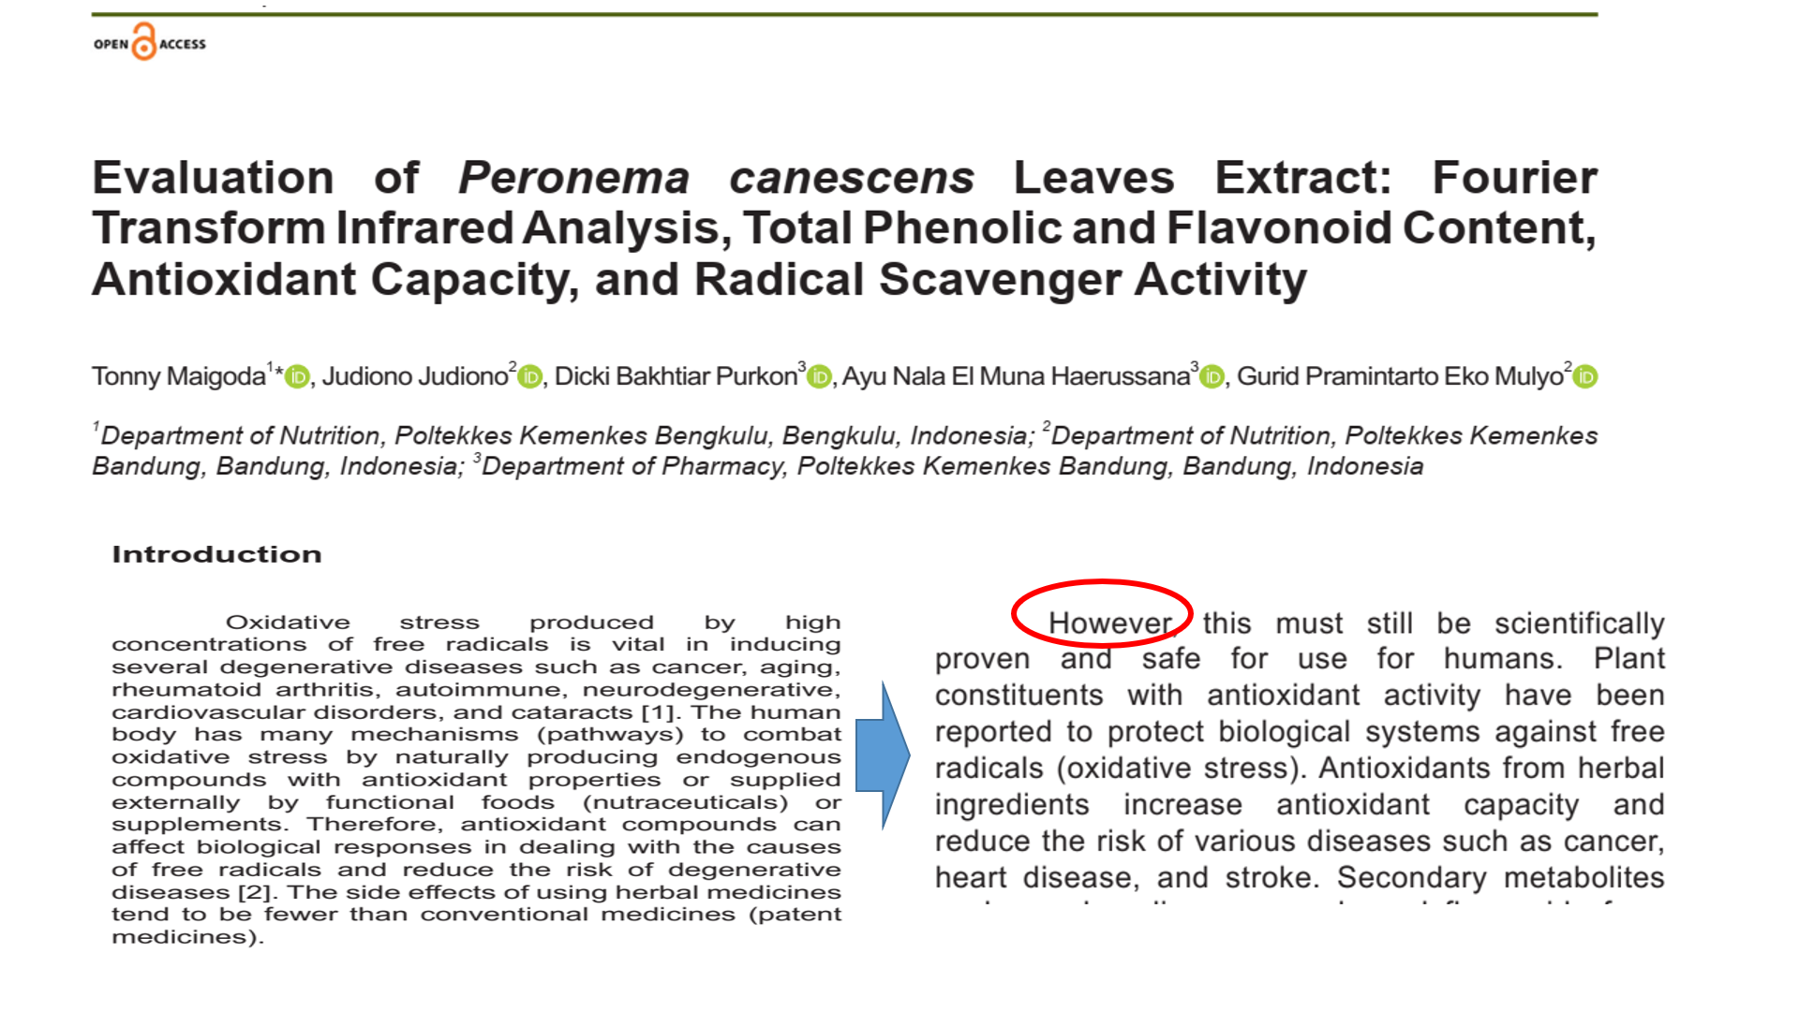

Slide 24
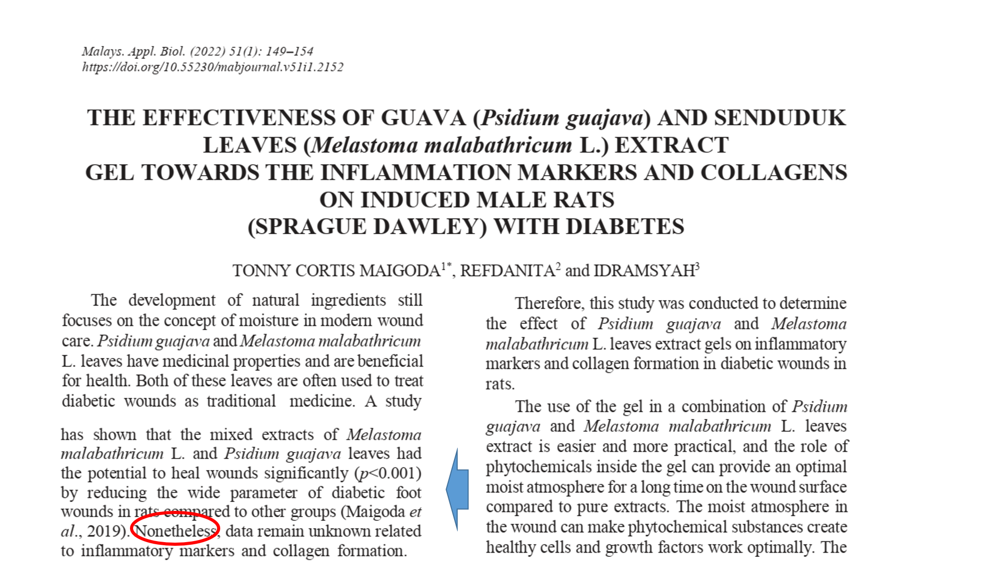

Slide 25
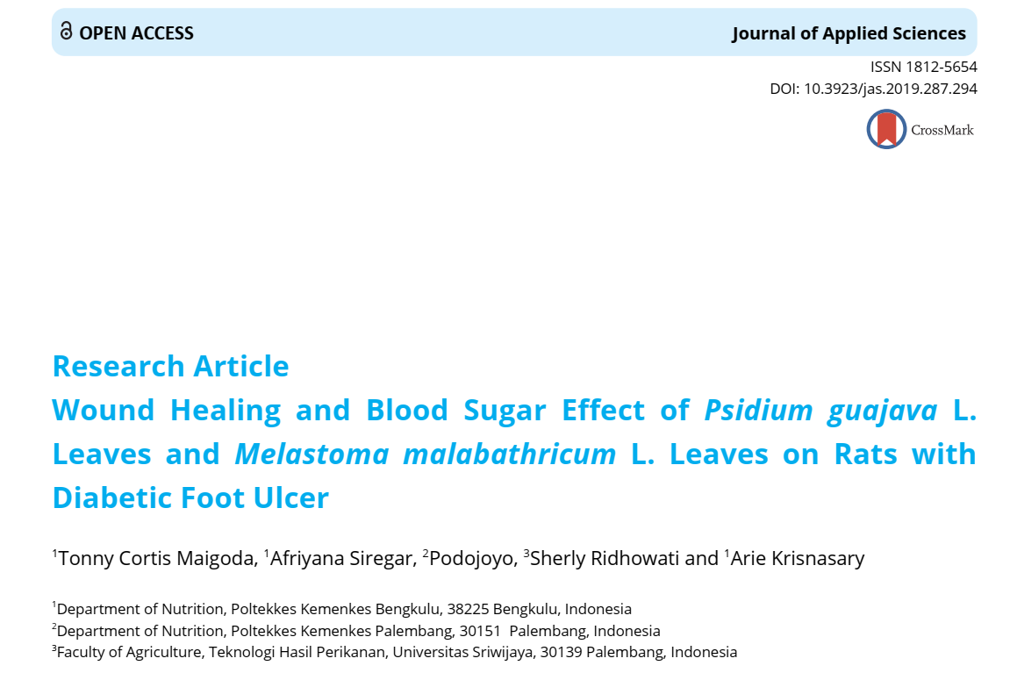
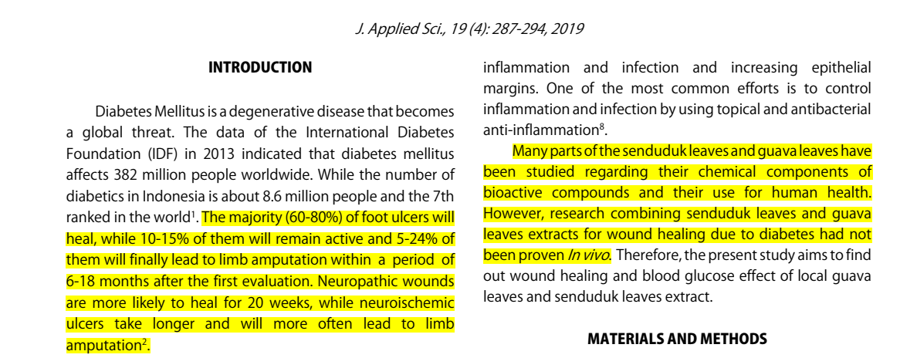

Slide 26
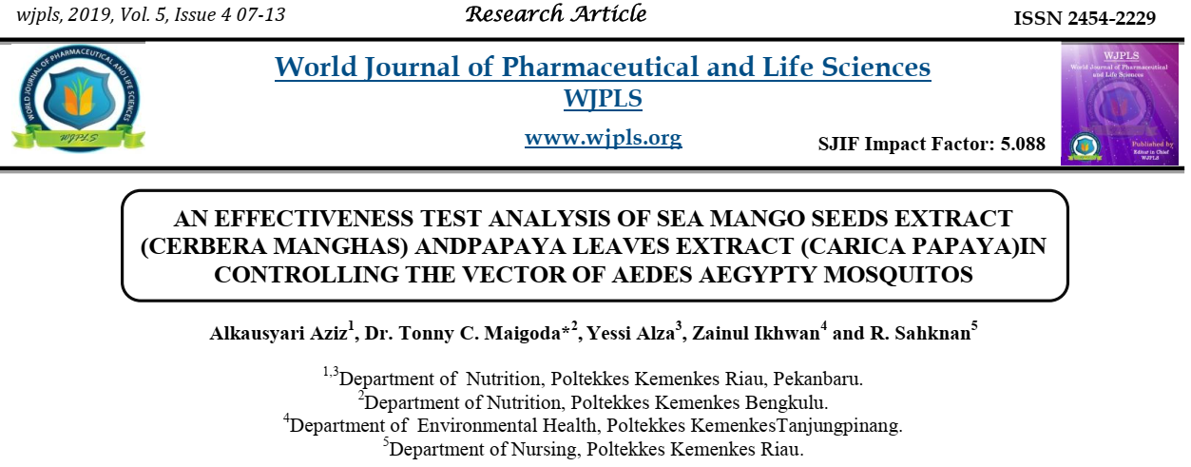
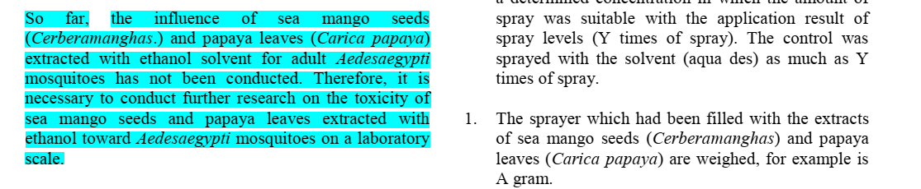

Slide 27

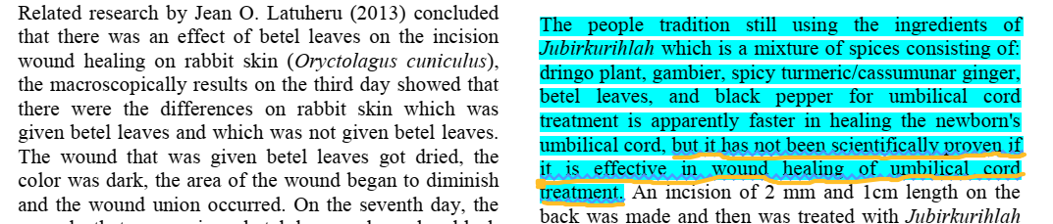

Slide 28
Writing the document
http://tutorialsbibtic.upf.edu/treball/
Be aware about formatting requirements (by the UPF, by the potential publisher)
Which is the style for your manuscript that should be followed by author guideline in each journal (see the section: template)
  http://www.upf.edu/bibtic/guiesiajudes/eines/tesis/presentar.html
Get familiar with IEEE, ACM, and APA citation styles
Use a bibliography manager:
  Zotero http://www.zotero.org/
  JabRef http://jabref.sourceforge.net/
  Mendeley http://www.mendeley.com/
  See for comparison tables:
  http://en.wikipedia.org/wiki/Comparison_of_reference_management_software

Slide 29
Organizing: asessing the rigour of your sources
Asessing the impact of authors, journals, articles:
  You can get or track authors’s impact indexes and more relevant info using
    Open Knowledge Maps (https://openknowledgemaps.org/)
    Publish or perish (http://www.harzing.com/pop.htm)
    Scimago (http://www.scimagojr.com/index.php)
    Arnetminer (http://www.scimagojr.com/index.php)
    Google Scholar (http://scholar.google.com/)
    Science Citation Index (several entry points – Library, for example)
    http://www.upf.edu/bibtic/en/guiesiajudes/eines/avalua/fi.html

Slide 30
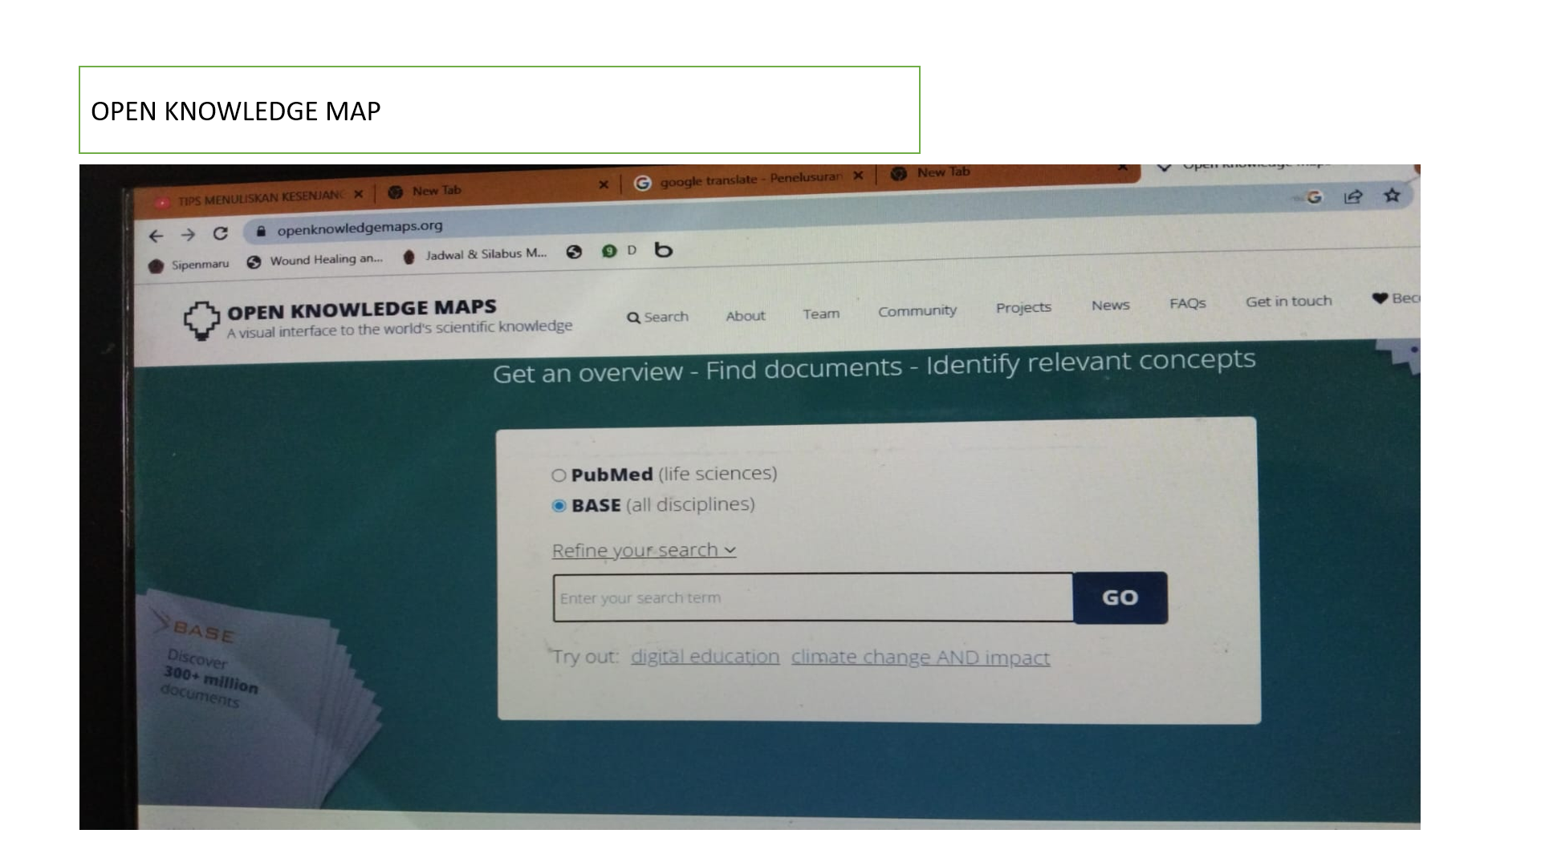

Slide 31
Organizing: Summarizing
Build a concept map
Try to determine which variables or dimensions make papers similar or different
Build tables summarizing information
Draw flowcharts

Slide 32
Conclusion
State-of-the-Art (SoTA) excavated and delivered with LITERATURE REVIEW
01
02
Try to find Research Gap before Writing your reseach proposal
Use any tools such as : open knowledge maps in orde to find a novelty in your topic research
03
04
Read Carefully and follow an author guideline on each journal

Slide 33
Recommendation
01
Keep trying and practice your writing skill
Create your mind map in order to explore your ideas
02
Read and read intensively and extensively. Start From Literatures review
03
Dont focus on perfection , nobody’s perfect
04
Notes:
If you fail it doesn’t mean you will lost for the next chance or opportunity

Slide 34

Science is a light in the darkness

